Slide 1
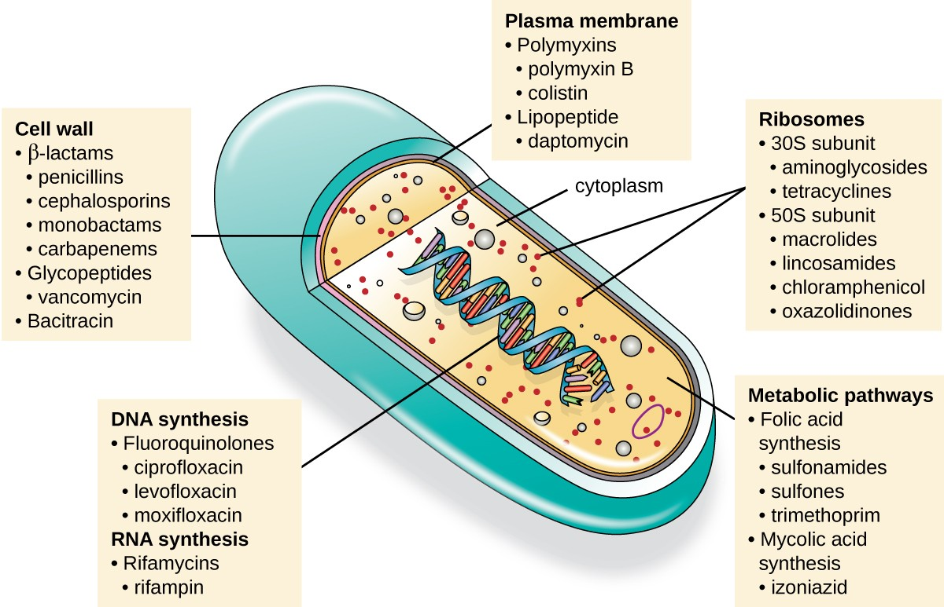
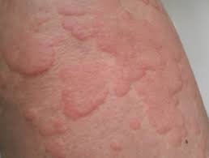
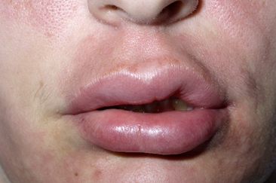
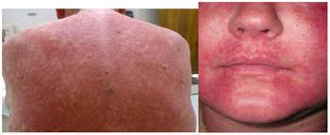
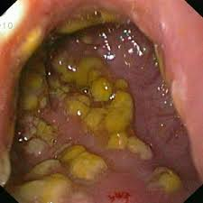
Antibiotics
Goals of antibiotic chemotherapy : toxic for invading organisms, not harmful to the host
Antibiotics targets
Bactericidal - penicillins, cephalosporins, aminoglycosides, quinolones
Time dependent killing - penicillins, cephalosporins, macrolides
Bacteriostatic - sulphonamide, tetracyclines, chloramphenicol
Antibiotics
Concentration dependent killing - aminoglycosides, quinolones
Penicillin
Cephalosporins
MOA - inhibition of peptidoglycan synthesis in the bacterial cell wall
• MOA - impair bacterial cell wall peptidoglycan synthesis
Classification | Drugs | Clinical uses
Group 1: narrow spectrum of activity | Benzylpenicillin, phenoxymethyl penicillin | Against S. pneumoniae & S. pyogenous
Group 2: penicillinase resistant penicillins | Cloxacillin, flucloxacillin | Against S. aureus
 | Methicillin and oxacillin | In laboratory sensitivity tests
Group 3: broad spectrum penicillins | Amoxicillin, ampicillin | Against Enterococcus faecalis, H. influenzae
Group4: antipseudomonal pencillins | Ticarcillin, piperacillin | Against P. aeruginosa
Classification | Drugs | Clinical uses
1st generation | Cefazolin, cefaclor, cefalexin | Uncomplicated URTI & LRTI, UTI
2nd generation | Cefuroxime ,cefoxitin & cefotetan | Typical community acquired pneumonia, URTI, UTI
3rd generation | Cefotaxime, ceftriaxone, ceftazidime ,cefixime | Septicaemia, pneumonia, meningitis
ADR – GI disturbances, type 1 hypersensitivity reactions
Beta lactamase inhibitors: clavulanic Acid, sulbactam, tazobactam
E.g. Co – amoxiclav = amoxicillin + clavulanic acid
Other beta lactam antibiotics
Monobactam - aztreonam
Carbapenems - imipenem, meropenem
Macrolides
ADR - Type 1 hypersensitivity reactions, diarrhoea, cholestatic jaundice, maculopapular erythematous rash
MOA - binds to bacterial ribosome and interfere with protein synthesis
Drug | Clinical uses | ADR
Erythromycin | Mycoplasma pneumonia, legionella infection | GI disturbances, diarrhoea
Clarithromycin | RTI, atypical pneumonia | GI disturbances rare
Azithromycin | RTI, soft tissue infections | GI effects are less than with erythromycin
Tetracyclines
MOA - interfere with protein synthesis by binding to bacterial ribosomes
Drugs | Clinical uses | ADR
Tetracycline, doxycycline, minocycline, tigecycline, demeclocycline | Active against Chlamydial infections, Mycoplasma, Rickettsiae, Borrelia | Heartburn, vomiting ,diarrhoea, sore mouth & sore throat, black hairy tongue, perianal soreness
Aminoglycosides
Nitroimidazoles
MOA - inhibit protein synthesis in bacterial ribosomes
MOA – prevent nucleic acid formation via DNA strand breakage
Drugs | Clinical uses | ADR
Gentamicin, ,neomycin, amikacin | Septicaemia, bacterial endocarditis, tuberculosis | Ototoxicity, nephrotoxicity, neuromuscular blockage
Drugs | Clinical uses
Metronidazole, tinidazole, ornidazole | Sepsis to which anaerobic organisms are contributing (Bacteroides spp. and anaerobic cocci), post -surgical infection , surgical prophylaxis, osteomyelitis
Sulfonamides and Trimethoprim
ADR – nausea, vomiting, unpleasant metallic, bitter taste in the mouth, furred tongue, diarrhoea
MOA - inhibit folate synthesis
Drug/s | Clinical uses
Sulfadiazine | UTI, meningococcal meningitis
Silver sulfadiazine | Prophylaxis & treatment of infected burns
Sulfasalazine | Inflammatory bowel disease, rheumatoid arthritis
Co - trimoxazole | Toxoplasmosis, nocardiasis
Glycopeptides - Vancomycin
MOA - inhibit cell wall synthesis; act on a site different to beta lactam antibiotics
Clinical uses - infective endocarditis (caused by MRSA), Streptococcal endocarditis (when allergy to benzylpenicillin)
ADR - ototoxicity, nephrotoxicity, allergy, red man syndrome
ADR – hepatitis, hypersensitivity reactions, bone marrow depression
Quinolones
Lincosamides – Clindamycin
MOA - inhibit negative supercoiling of DNA
MOA - inhibit protein synthesis by binding to bacterial ribosomes
Drug/s | Clinical uses
Nalidixic acid | UTI
Ciprofloxacin, norfloxacin, ofloxacin ,levofloxacin, | UTI, GI infections, RTI
Clinical uses - Staphylococcal bone & joint infections (Methicillin resistant), serious intraabdominal sepsis
ADR - pseudomembranous colitis
ADR – allergic reactions, inhibit liver enzymes, C. difficile associated diarrhoea

